Slide 1
R – Basics and Workflow
Zaw Myo Tun
University of Medicine, Mandalay
16 March 2020

Slide 2
Outline
Why R?
R and Rstudio
Notebook
Basics
Data transformation {dplyr}
Data visualisation {ggplot2}
Workflow

Slide 3
Why R?
Reproducibility
Powerful built-in base statistics package
Broad user base, especially in science
Helpful community (Twitter, Blogs)
Flexibility/Programming environment
Compatibility with other programming languages
Open source—transparency

Slide 4
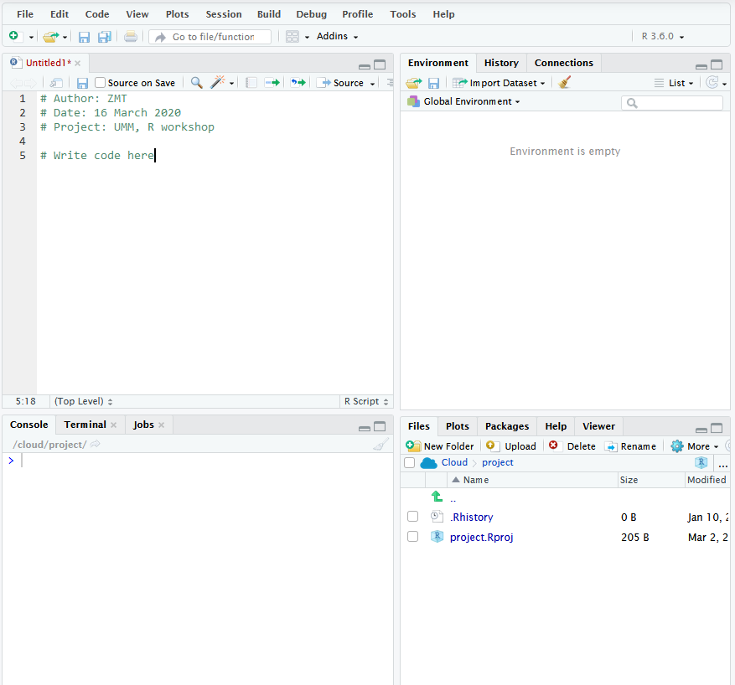
R and RStudio

Slide 5
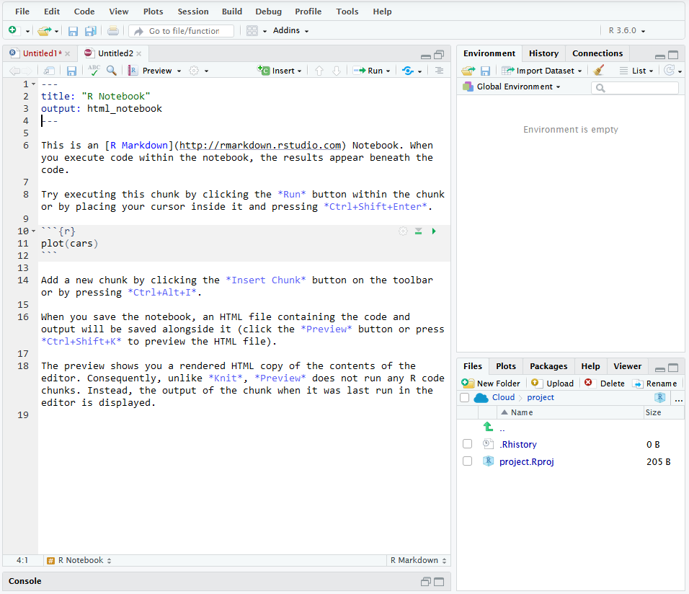
Notebook

Slide 6
Hands-on exercise
Basics
Data transformation
Data visualisation

Slide 7
Workflow
How to structure folders
How to name files
https://speakerdeck.com/jennybc/how-to-name-files?slide=3
RStudio Project
Practice safe paths
https://rstats.wtf/project-oriented-workflow.html

